Slide 1

AI-Powered Cinnamon Grading System
NIB 7088
Artificial Neural Network Course Work
MSc. Data Science
Coventry University, UK
M.D.P. Wijesuriya
Student ID (Coventry Uni.): 15764609
Student ID (NIBM): comscds241p-002
2024 Batch

Slide 2
Introduction & Background
Cinnamon is a high-value export commodity
Grading determines price, quality, and market allocation
Manual grading is inconsistent, subjective, and time-consuming
Need for automation using data-driven methods

Slide 3
Project Objectives
Develop automated grading system for cinnamon
Ensure consistency and high accuracy in classification
Apply Artificial Neural Network for prediction
Use Explainable AI (SHAP) for transparency

Slide 4
Dataset & Features
Dataset: 8692 Cinnamon Samples
12 measured features (Moisture, Ash, Volatile Oil, etc.)
3 Levels of Quality Gradings Classes (Quality Labels - High, Medium, Low)
Sample count for each class:
Quality Label | Count
High | 2944
Medium | 2889
Low | 2859

Slide 5
Feature Description
Moisture – Water content in cinnamon. This affects freshness and shelf life.
Ash – Total mineral residue after burning which indicates purity.
Volatile Oil – Aromatic oil content. The key for flavor and fragrance.
Acid Insoluble Ash – Non-digestible mineral impurities (e.g., sand, dirt).
Chromium – Trace element level, which the excess can be harmful.
Coumarin – Natural compound that high levels may be toxic, important for safety.
Fiber – Structural content that affects texture and grade.
Density – Weight per volume which helps in quality classification.
Oil Content – Total extractable oil that influences aroma, flavor, and quality.
Resin – Sticky organic substances that affects consistency.
Pesticide Level – Chemical residues from cultivation that linked to safety standards.
pH Value – Acidity/ Alkalinity which affects chemical stability and preservation.

Slide 6
Methodology – Model Development (Classic ML)
Model | Accuracy (%) | Training Time (s) | Prediction Time (s)
Logistic Regression | 82.35 | 0.02 | 0.0000
Random Forest | 89.88 | 1.13 | 0.0724
Support Vector Machine | 91.20 | 18.40 | 0.3267
Best Classical Model: Support Vector Machine (SVM) with 91.20% accuracy

Slide 7
Better Prediction Using ANN
Complexity of the Problem
Higher Accuracy Requirement
Better Feature Representation
Scalability and Adaptability
Generalization to Noisy Data
Alignment with Industry Trends

Slide 8
Methodology – Model Development (ANN)
Model Architecture
ANN Architecture: Input Layer, 2 - Hidden Layers (128, 64), Output Layer
Dropout Rate: 0.2
Optimizer: Adam - To adjust models' weights while learning
Loss function: Cross-entropy
Train/Test split: 80/20
Handle Class imbalance: Weighted Random Sampler
Training Hyperparameters
Batch size: 64
Learning rate: 0.001
Number of epochs: 150
Weight decay: 1e-4
Scheduler factor: 0.5
Scheduler patience: 10

Slide 9
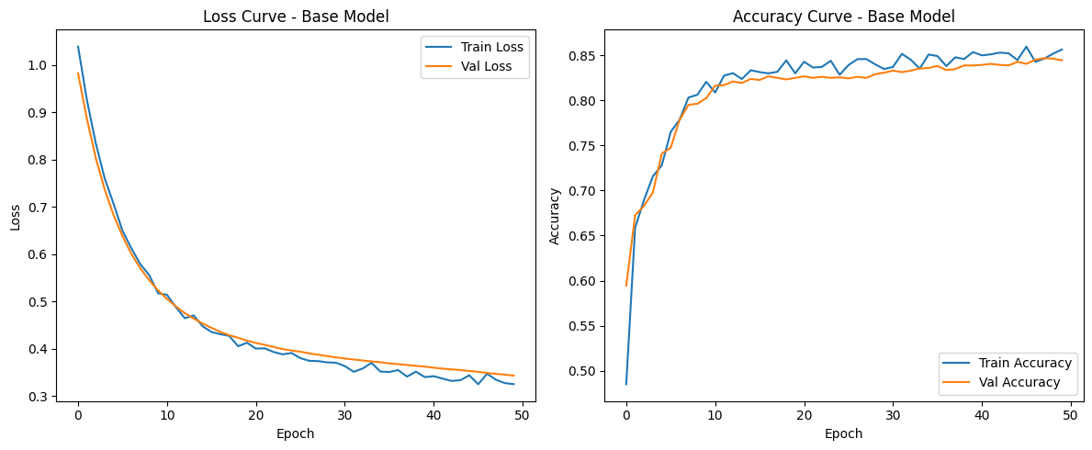
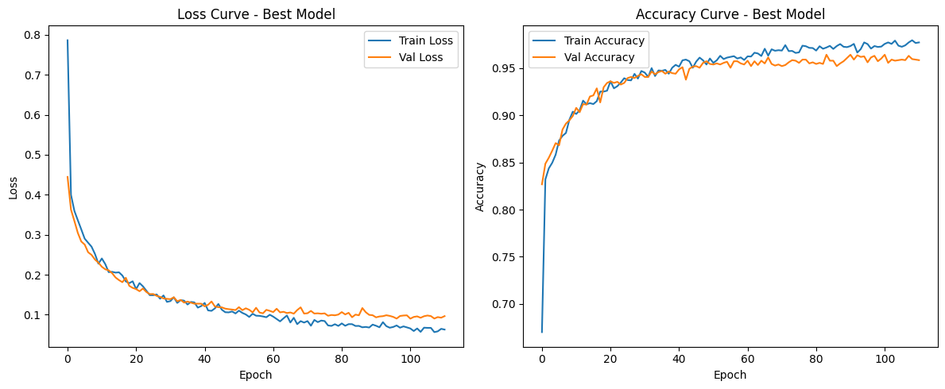
Results & Findings
Training Performance

Slide 10
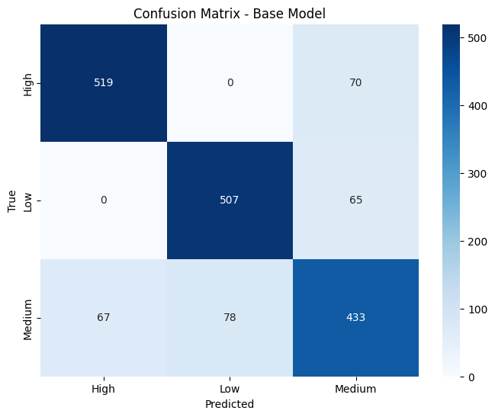
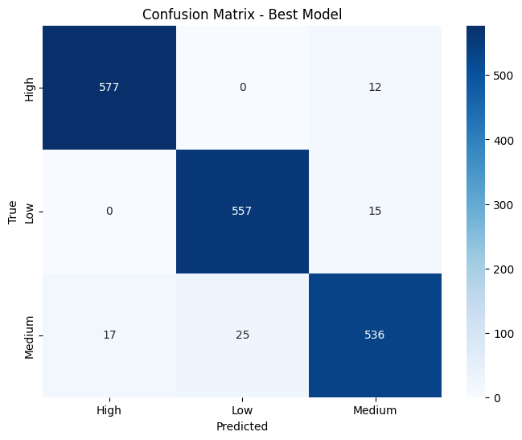
Results & Findings
Confusion Matrices
Class | Base Model |  | Best Model |  | Error Reduction
 | Correct | Errors | Correct | Errors | (%)
High | 519 | 70 | 577 | 12 | 82.9%
Low | 507 | 65 | 557 | 15 | 76.9%
Medium | 433 | 145 | 536 | 42 | 71.0%

Slide 11
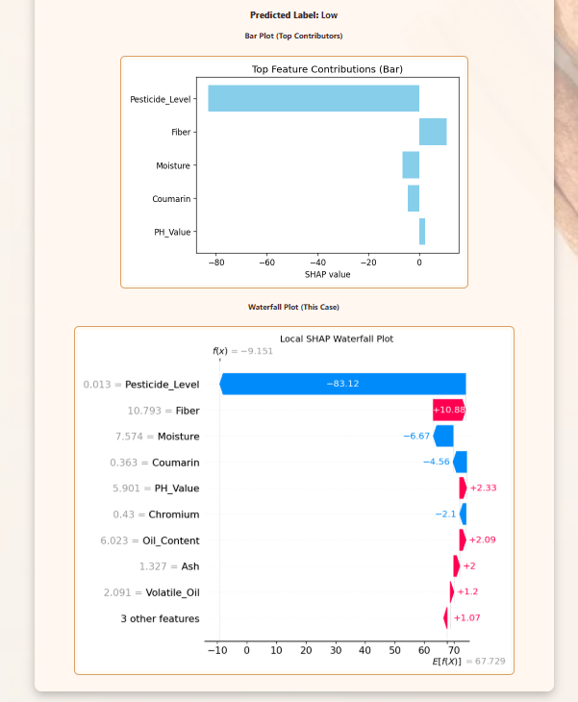
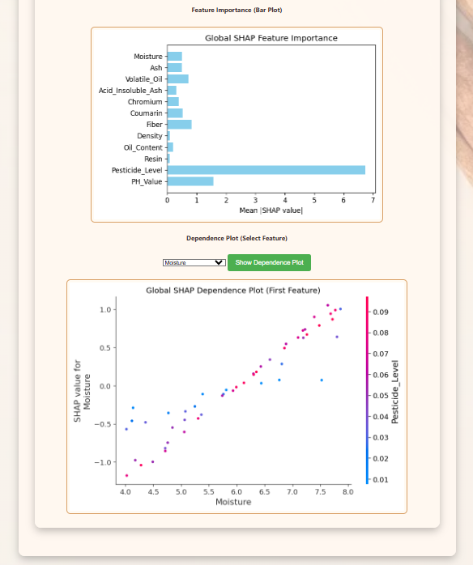
Explainability AI
SHAP (Shapley Additive exPlanations) used
Global level: overall feature influence
Local level: per-sample explanations
Improves trust and interpretability

Slide 12
Conclusion
ANN successfully applied for cinnamon grading
SHAP ensures explainability and stakeholder trust
Feasible AI-powered quality control in agriculture
Industry benefits: faster grading, consistency, transparency

Slide 13
References & Acknowledgements
Data sources: The Spice Council

